Slide 1
Digital Portfolio
STUDENT NAME: S.AYESHA SUHAINA
REGISTER NO: 24134110500122006
NM ID : 48A4BAEF1A7667B85C8439E05226A8BA (asanm41124134110500122006)
DEPARTMENT: BCA
COLLEGE:VIVEKANANDA ARTS AND SCIENCE COLLEGE(W),SIRKALI
ANNAMALAI UNIVERSITY ,CHIDAMBARAM

Slide 2
PROJECT TITLE
STUDENT DIGITAL PORTFOLIO

Slide 3


AGENDA
Problem Statement
Project Overview
End Users
Tools and Technologies
Portfolio design and Layout
Features and Functionality
Results and Screenshots
Conclusion
Github Link
3/21/2024 Annual Review

Slide 4

PROBLEM STATEMENT
In Today’s Digital world, Students and professionals need an online presence to show their skills and projects
A Digital Portfolio Provides an interactive and visually appealing way to present skills and achievements

Slide 5

PROJECT OVERVIEW
The project is to built a digital portfolio using HTML,CSS and JavaScript
It Contains Personal details,Skills,Project
and Contact of a person
It is fully responsive and work on all devices

Slide 6

WHO ARE THE END USERS?
STUDENT: To Share Academic Work , Project and Skills
JOB SEEKERS: Present Portfolios to recruiters in a professional and interactive way
FREELANCERS: To highlight previous works and attract clients
4.PROFESSIONALS: To maintain a personal brand and career portfolio

Slide 7

TOOLS AND TECHNIQUES
HTML : Used for Website contents and structure
CSS: Used for Website Design, Style and layout
JavaScript : For Interactive features and to interact with users

Slide 8
POTFOLIO DESIGN AND LAYOUT
Navigation Bar– Fixed with toggle menu for mobile
Home – Animated gradient background with introduction
About – short description about self Skills
Projects – List with hover effects
Contact – Email
8

Slide 9
FEATURES AND FUNCTIONALITY
Mobile-friendly responsive designs
Project showcase with hover animations
Easy navigation across sections
Direct contact options

Slide 10
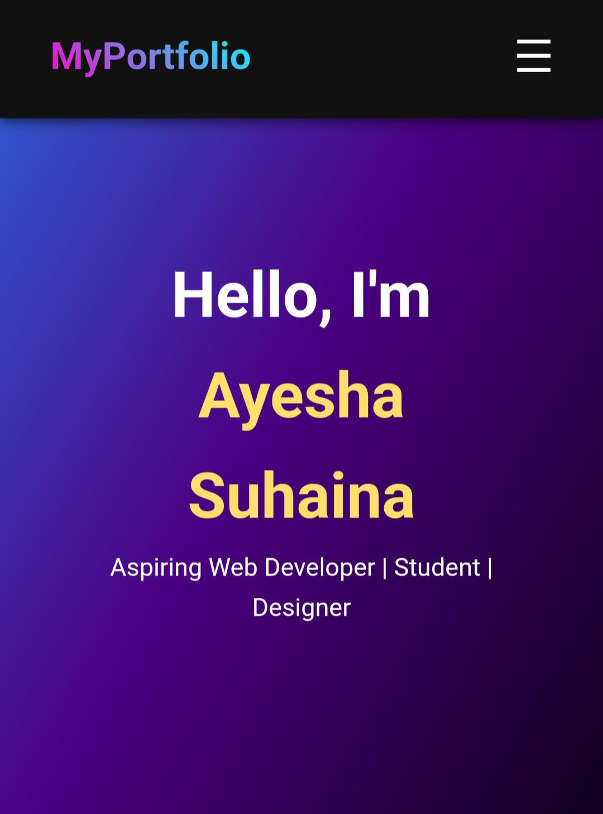
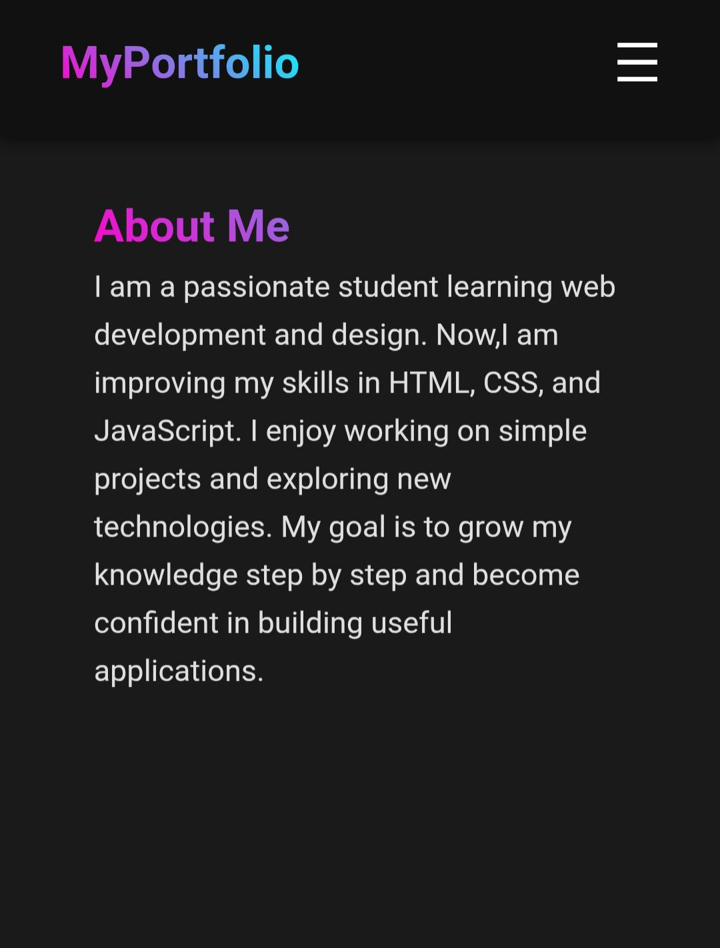
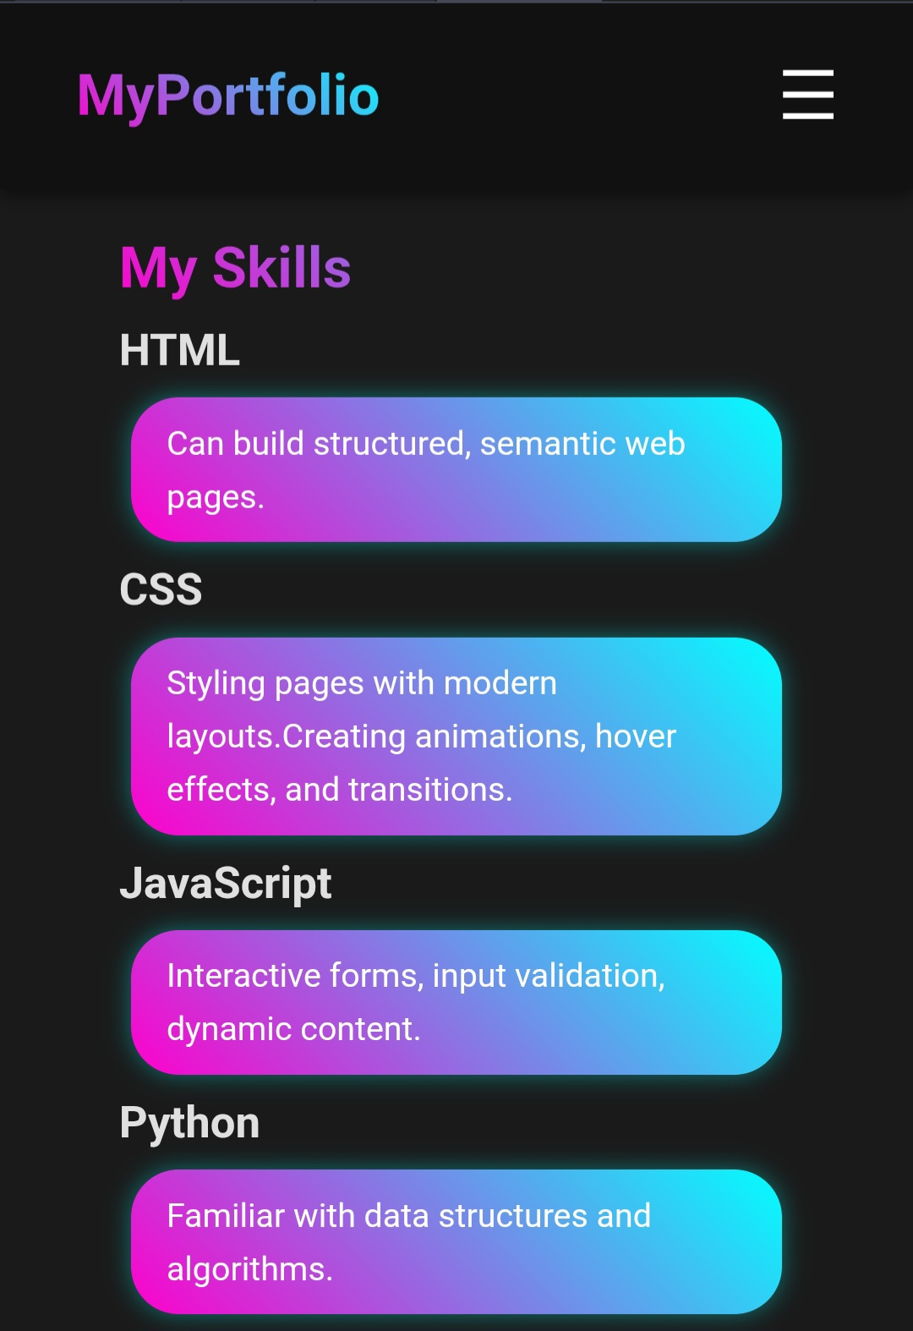

RESULTS AND SCREENSHOTS
3/21/2024 Annual Review
10

Slide 11
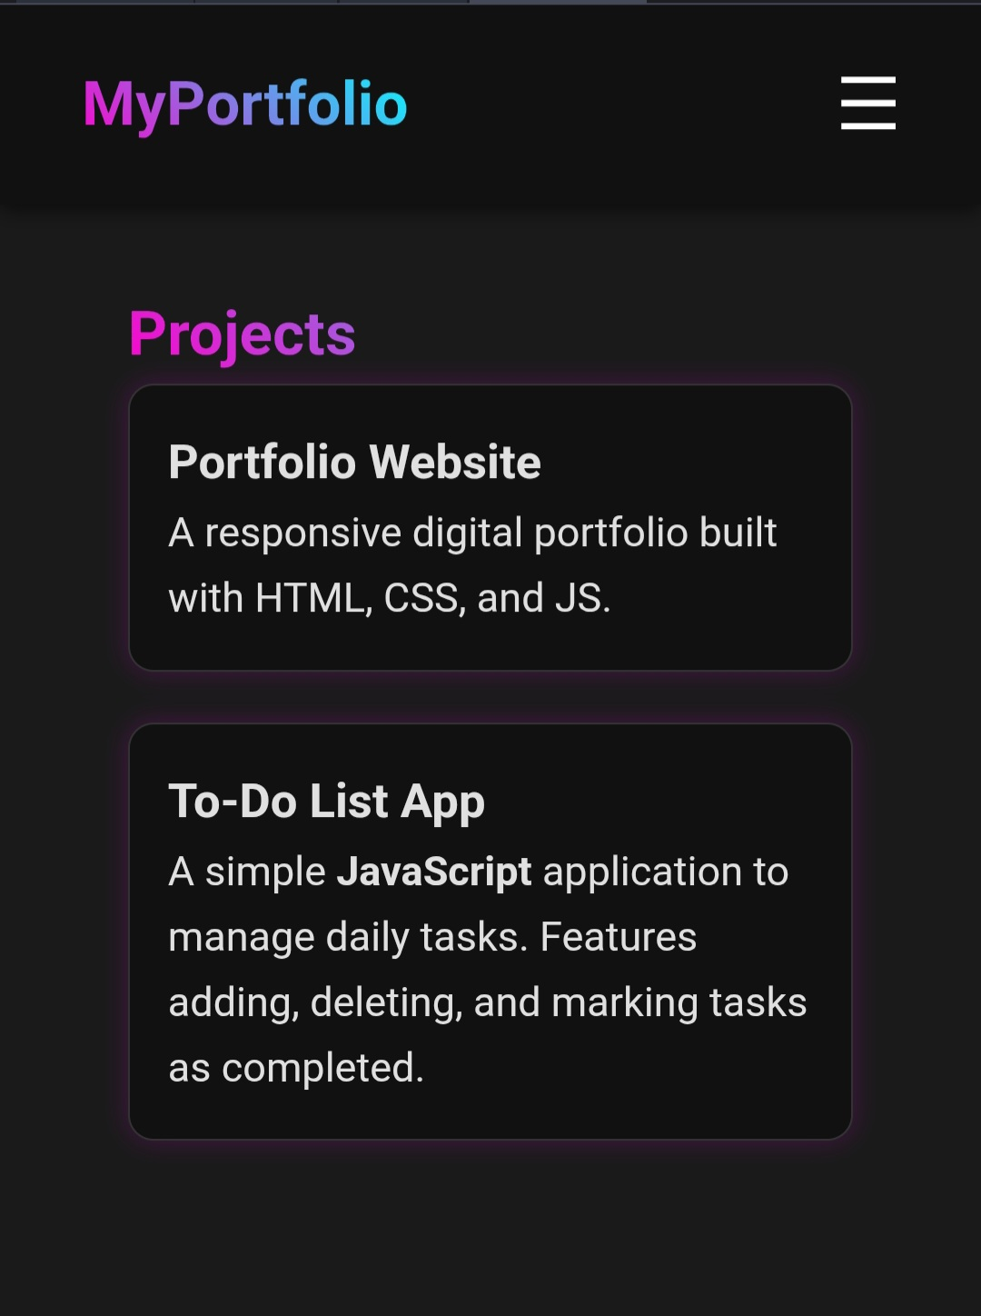
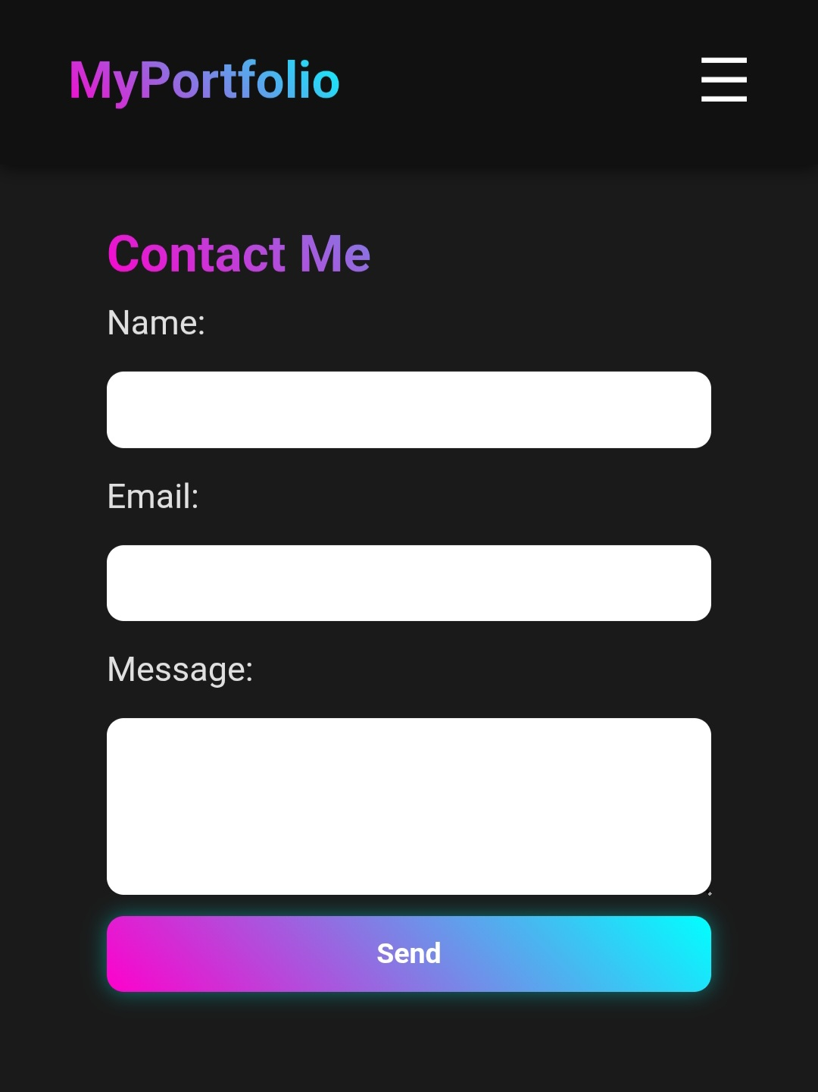
Result And Screenshots

Slide 12
GitHub link
https://github.com/AyeshaSuhaina/Ayesha-Suhaina-TNDC-FWD-DP.git

Slide 13
CONCLUSION
This digital portfolio provides a modern, responsive, and interactive platform to showcase personal and professional achievements. It enhances online presence, improves career opportunities, and demonstrates technical skills in web development.
13

